Slide 1
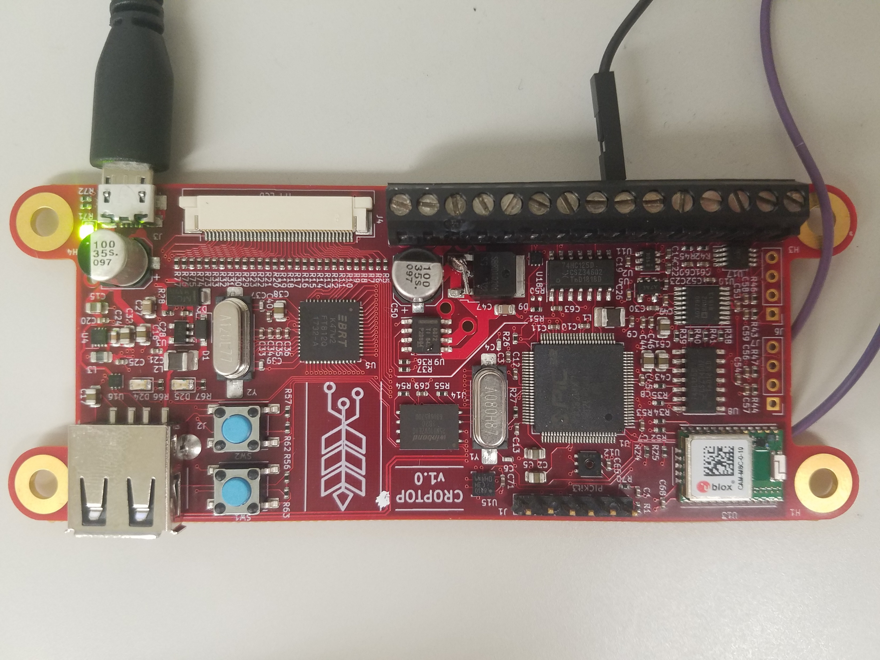
Cereal Grain Data Acquisition Device
Ned Caisley and Ryan Donahue

Slide 2
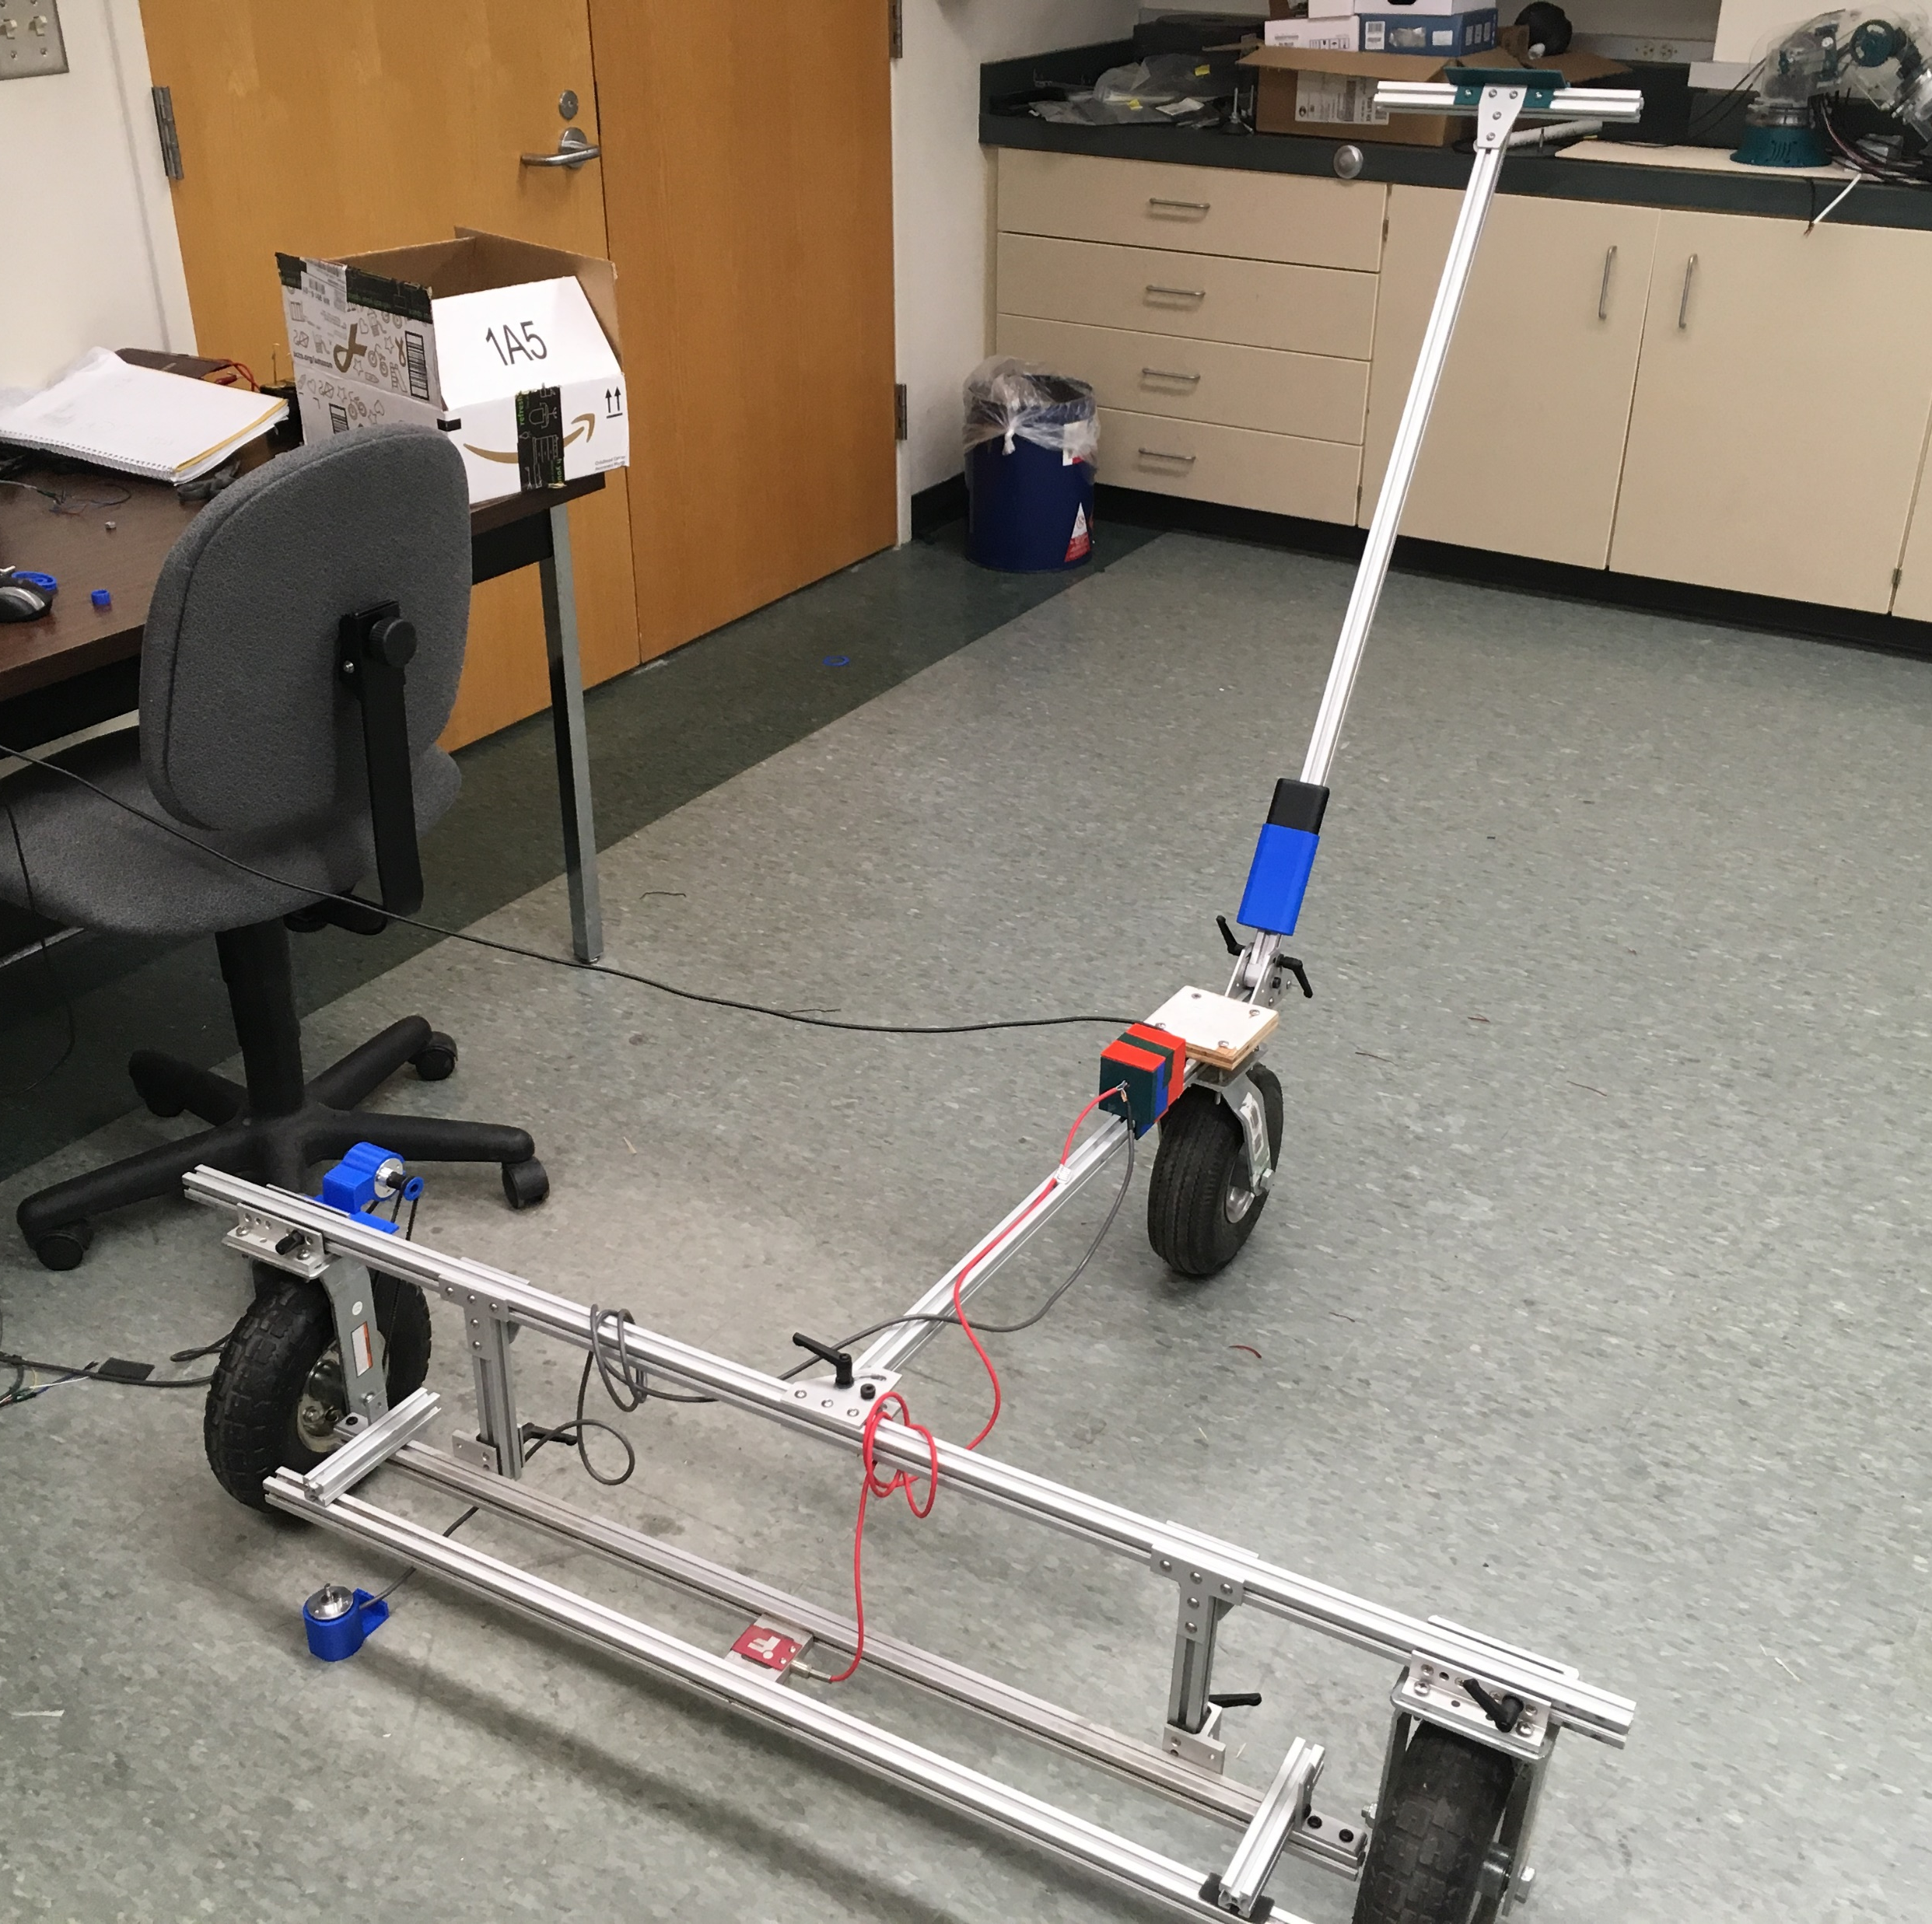
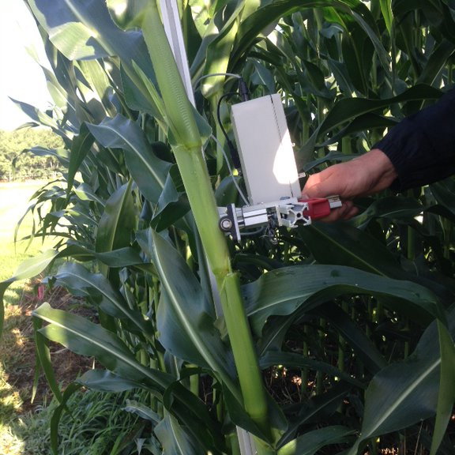
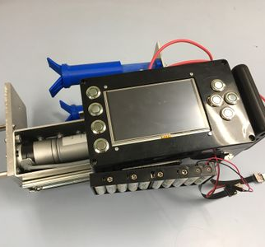
Project Scope

Slide 3
Where we are in HW

Slide 4
Where we are in SW

Slide 5
Where we are going in HW

Slide 6
Where we are going in SW

Slide 7
Questions we have for you

Slide 8
Other Things:
Budget
Timeline
How will we document / handoff

Slide 9
Slides that will help answer questions:
Schematic
Board Layout

Slide 10
Title

